Slide 1
Agency Project
Scotland County DSS: Work First Employment Services Contract Book
April Martin

Slide 2
What is the project? What is the WFES contract book?
This project is to update the work experience contract book that the Work First Employment Services (WFES) social worker’s utilize when placing their clients on work sites to complete their work experience hours for the Work First Program.
The contract book consists of signed contacts from agencies and businesses throughout Scotland, Robeson, and Richmond Counties that have agreed to let the WFES clients complete their work experience hours in order to receive their TANF checks.

Slide 3
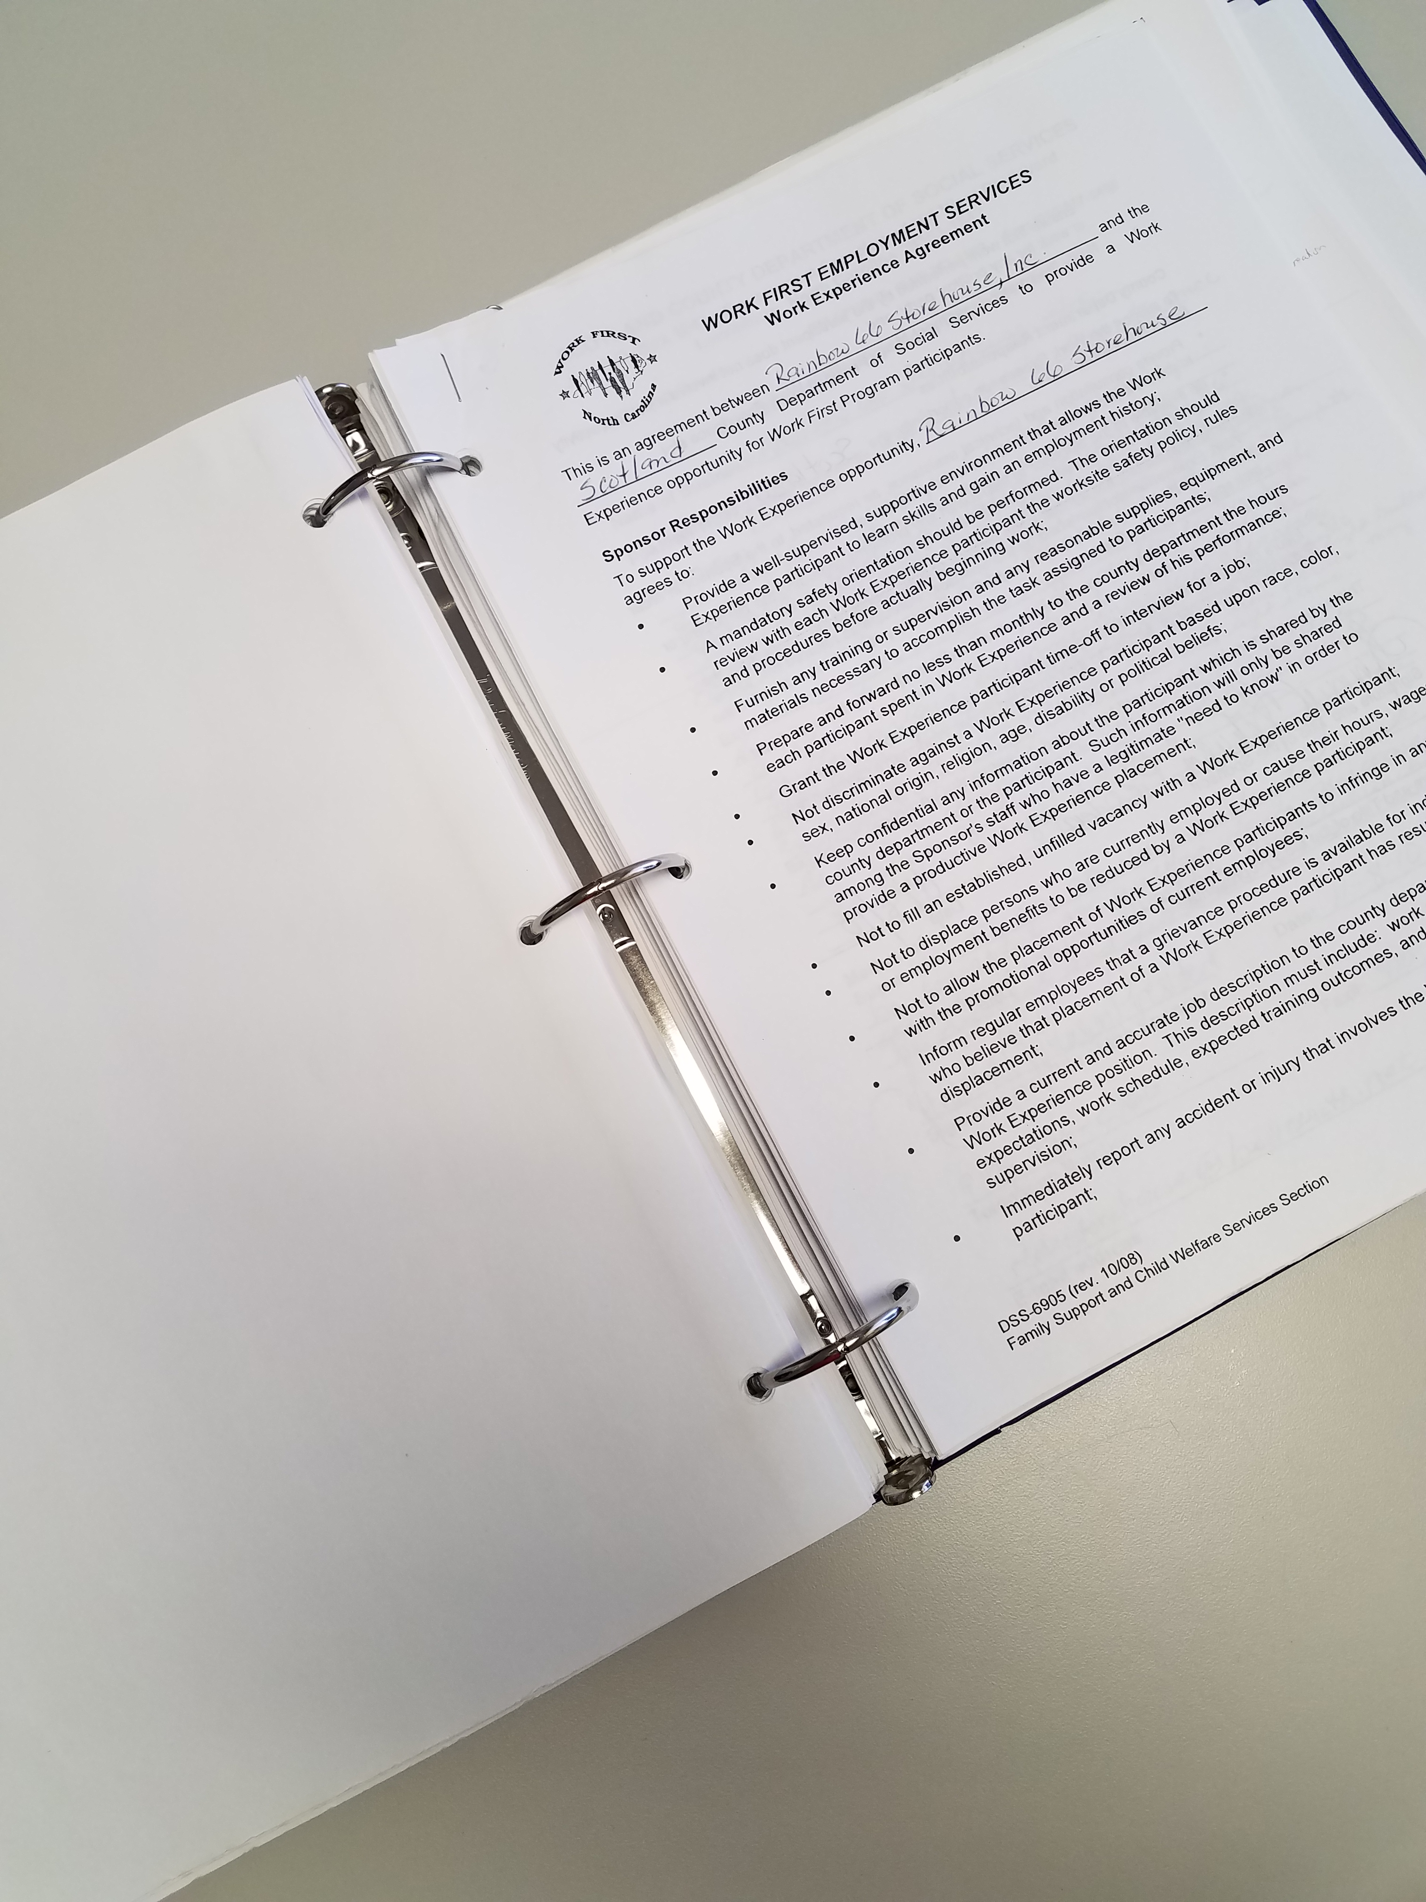
Work First Employment Services Contract Book

Slide 4
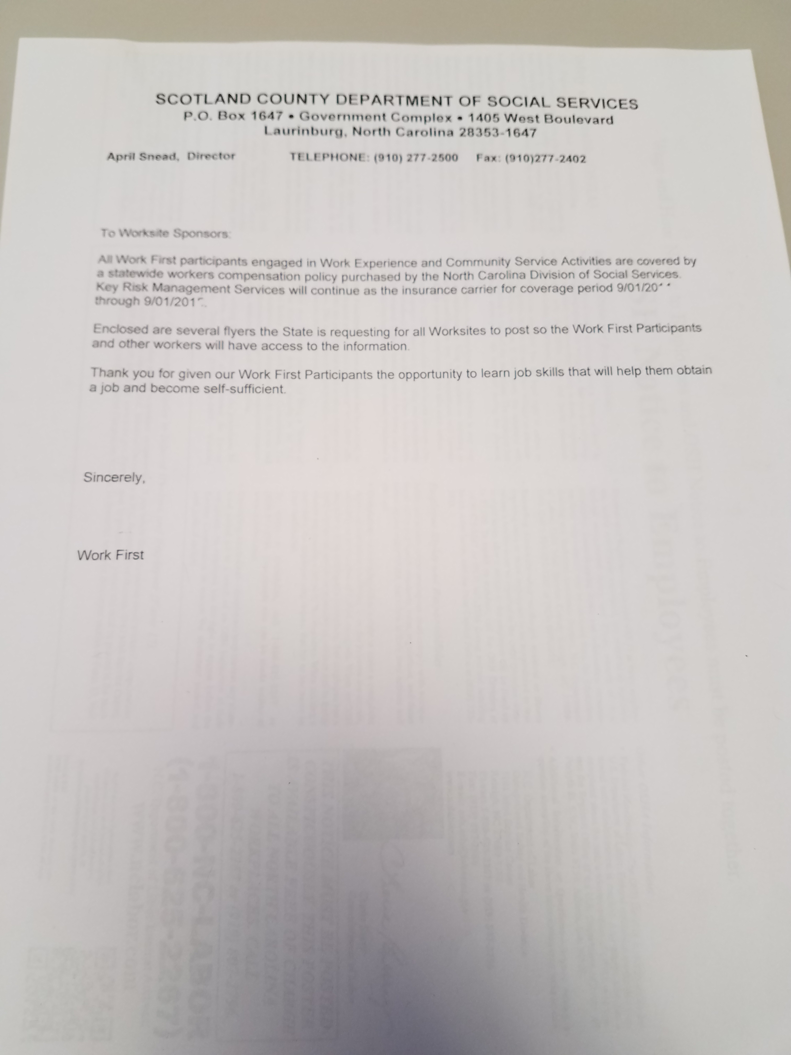
Contract and Workers Comp. Forms

Slide 5
Who will this project benefit?
The Work First Employment Services (WFES) social workers as well as the agency
The clients completing work experience hours in the WFES program
Agencies and businesses in Scotland County

Slide 6
Where will the project take place?
Scotland County Department of Social Services
Agencies and Businesses within the community

Slide 7
When will the project take place?
As there is no limit on the number of work experience contracts that the agency can have, I will continue to work on this project for the duration of my internship. I will update old contracts and recruit new contracts so that the social workers will have a plethora of work sites in which they can place their clients.

Slide 8
Why is the project being done?
The contract book need to be updated. Some of the businesses and agencies are either no longer opened, they no longer with to participate or they have different contact information.
Some of the contracts just need to be updated because they were signed 6 or more years ago under old management.
I have recruited several new businesses in the area who are eager to work with our clients. Also, I have had many of the older contracts updated that were either never used or who have gone under new management without any knowledge that the contract even existed.

Slide 9
Competencies & Practice Behaviors
Demonstrate ethical and professional behavior
Engage diversity and difference in practice
Advance human rights and social, economic, and environmental justice
Engage in practice-informed research and research-informed practice
Engage in policy practice
Engage with individuals, families, groups, organizations, and communities
Assess individuals, families, groups, organizations, and communities
Intervene with individuals, families, groups, organizations, and communities
Evaluate practice with individuals, families, groups, organizations, and communities

