Slide 1
NAMI: National Alliance on Mental Illness
April Martin

Slide 2
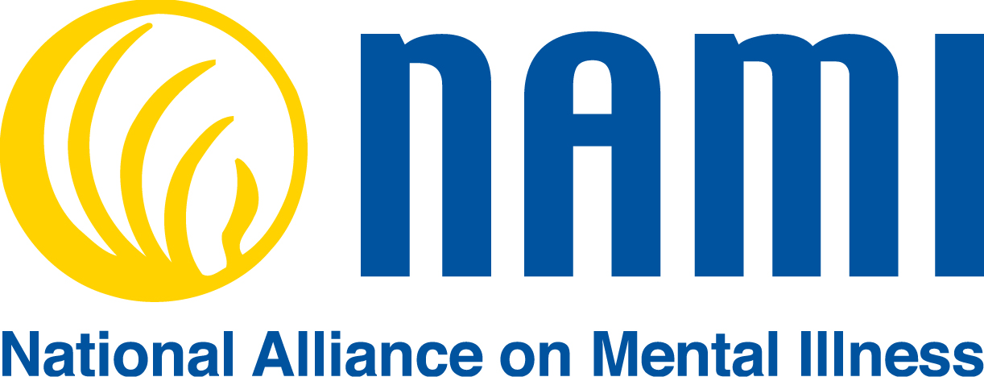
About NAMI:
http://www.nami.org/About-NAMI

Slide 3
Dear Senator McInnis,
My name is April Martin and I am a social work student at the University of North Carolina at Pembroke. I am writing to you about my concern for the lack of school based mental health services. As a member of the National Alliance on Mental Illness (NAMI), I feel that it is important for the future of our children and society as a whole to pass the H.R. 1211 bill – Mental Health in Schools Act. Mental health issues among youth is an escalating problem that needs to be addressed. This bill was introduced to the house in March of 2015 and a summary of the bill is listed below;
Mental Health in Schools Act of 2015
Amends the Public Health Service Act to revise a community children and violence
program to assist local communities and schools in applying a public health approach to mental health services, including by: (1) revising eligibility requirements for a grant, contract, or cooperative agreement; and (2) providing for comprehensive school mental health programs that are culturally and linguistically appropriate, trauma-informed, and age appropriate. Requires a comprehensive school mental health program funded under this Act to assist children in dealing with trauma and violence. Makes only a partnership between a local educational agency and at least one community program or agency that is involved in mental health eligible for funding.
Requires the Substance Abuse and Mental Health Services Administration to develop a fiscally appropriate process for evaluating grant program activities, including the development of: (1) guidelines for the submission of program data by recipients; and (2) outcome measures to be applied by recipients in evaluating programs, including student and family measures and local educational measures.
Studies have shown that if mental health issues in youth are addressed at an early onset, mental health professionals in educational settings can provide appropriate treatment. Early intervention will increase the chances of children becoming successful students. After examining additional bills that you sponsor, I can see that education is important to you and I have good faith that you will do your part to ensure that the H.R. 1211 bill will be passed for the well-being of our children.
Respectfully,
April Martin

