Slide 1
Social Work Competency #2
Engage Diversity and Difference in Practice
April Martin

Slide 2
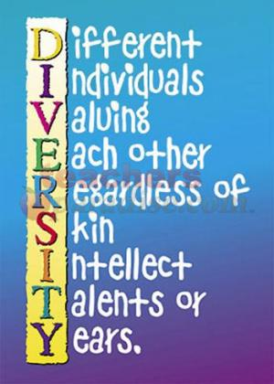
Apply and communicate understanding of the importance of diversity and difference in shaping life experiences in practice at the micro, mezzo, and macro levels.
Diversity is importance in any agency/practice setting. As a social worker, you must be mindful that every culture is different and each person does, reacts, and responds to circumstances differently.
Social workers need to be aware of the diverse populations within the area in which their agency/practice serves so that they are able to provide for and help their clients as best they can.

Slide 3
Present themselves as learners and engage clients and constituencies as experts of their own experiences.
As social workers, we only know what the client reveals to us therefore it is important that we allow the client to “teach” us in regards to how and why they do things different.
We must also understand that just because someone has their own way of doing something doesn’t make it wrong as long as no one is in danger and no laws are being broken.

Slide 4
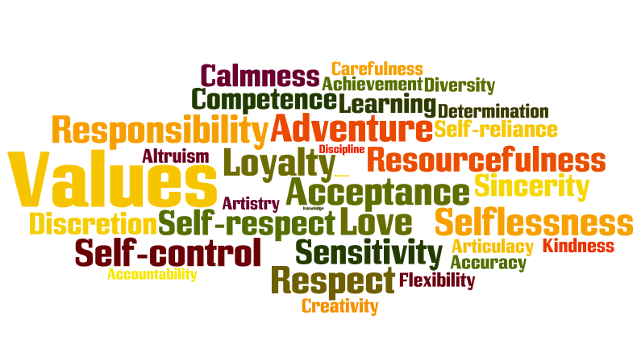
Apply self-awareness and self-regulation to manage the influence of personal biases and values in working with diverse clients and constituencies.
At some point, we as social workers will have a case in which we have personal biases. It is only fair to the client that your personal conflict does not impede on your ability to help that person. Remembering the values and ethics of the NASW are very important.

